Slide 1




DEPHINAZZ COMMERCIALS WEBSITE
How we make our website using dreamweaver with template
Disediakan oleh Group 3:
Daniel Hakim, Glenn Sachiel, Hazriesham

Slide 2
DEPHINAZZ COMMERCIALS WEBSITE
How we make our website using dreamweaver with template
Disediakan oleh Group 3:
Daniel Hakim, Glenn Sachiel, Hazriesham

Slide 3

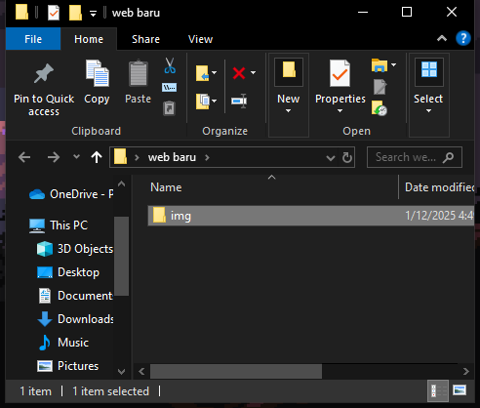
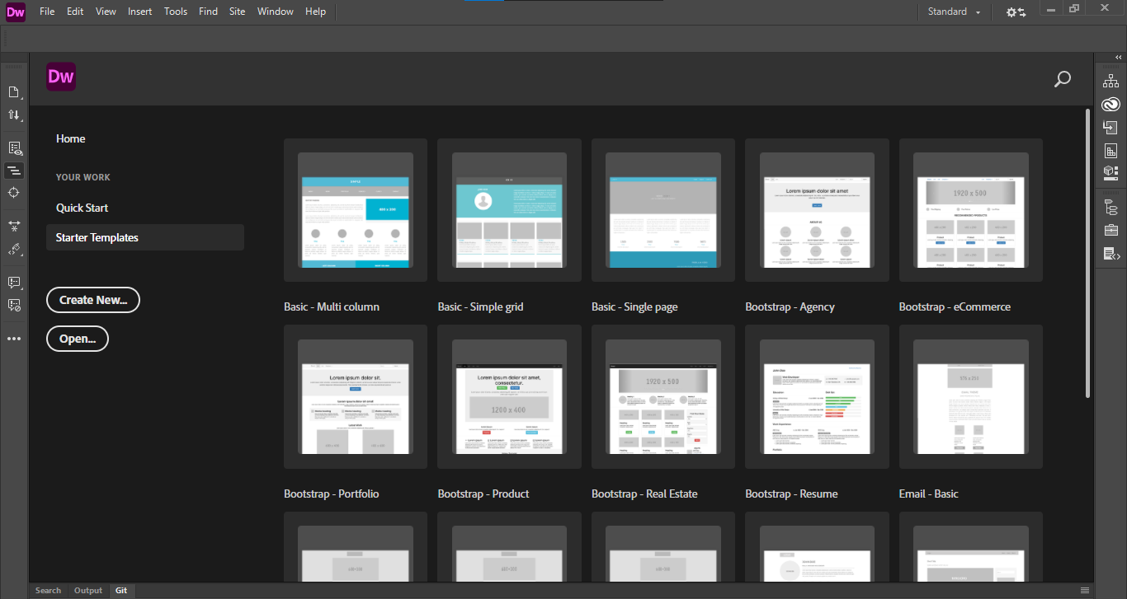
1. Setup your website
Create your website folder on your desktop
Then create an image folder for your image

Slide 4
Click to Starter Template
2. Then, open your Adobe Dreamweaver

Slide 5
Click to Starter Template

Slide 6
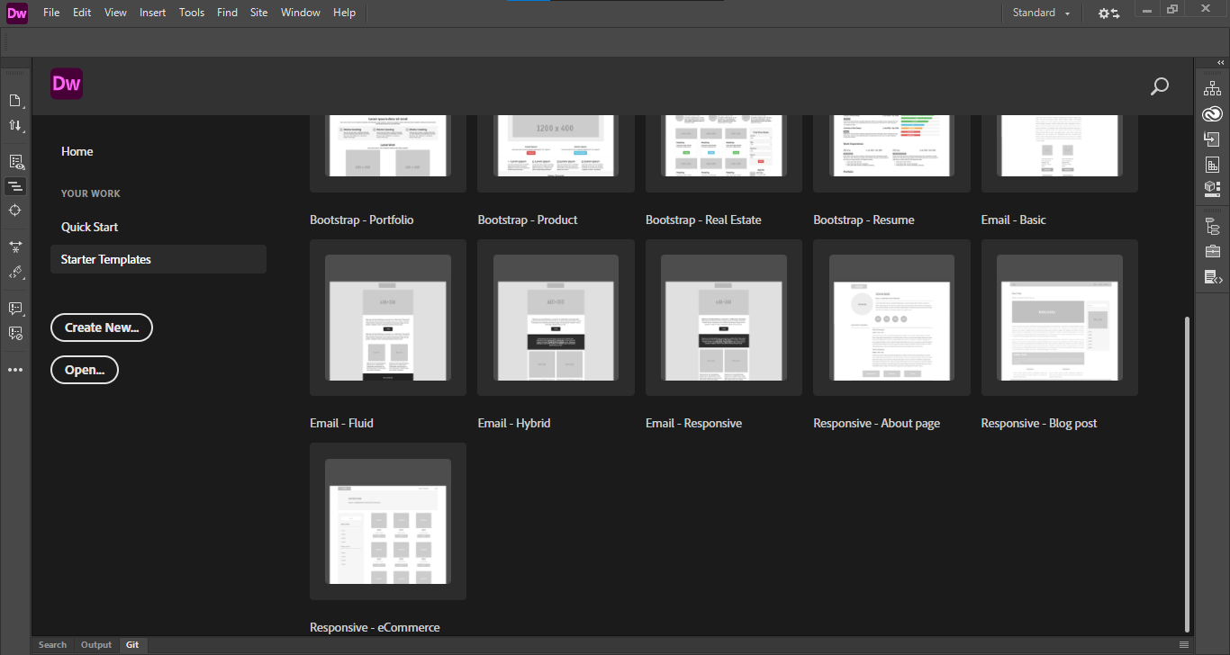
Scroll down and search for eCommerce Template

Slide 7
Click at the template

Slide 8
You will get this interface

Slide 9
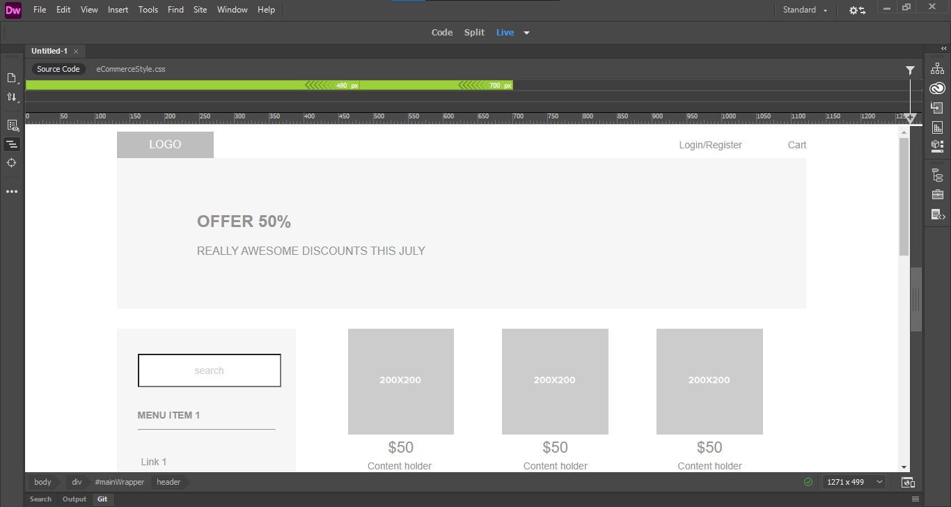
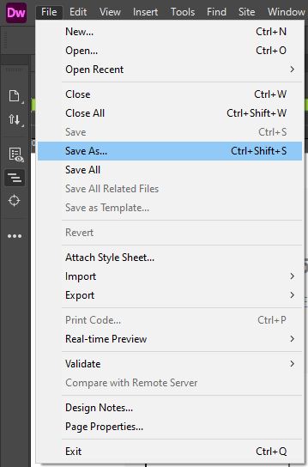
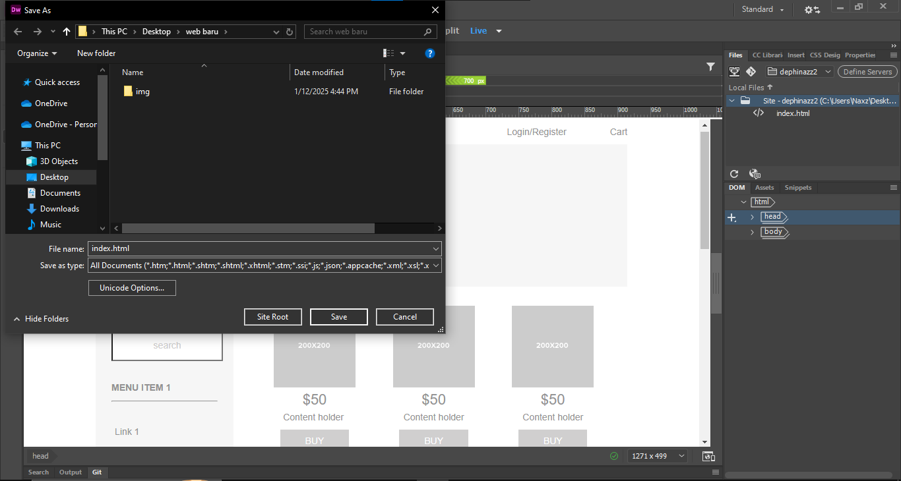
Save your web first into your web folder with name “index.html” as home page

Slide 10
Now how to change the banner

Slide 11
Click this section on your dreamweawer

Slide 12
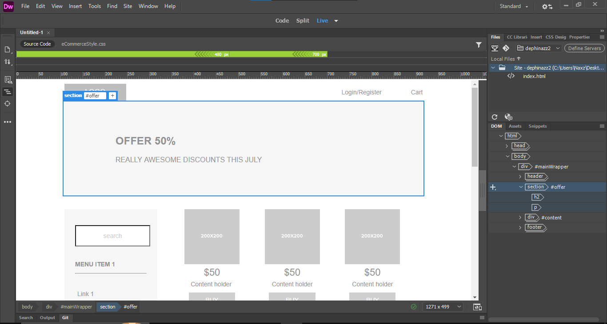
Section elemen will selected on right DOM tabs

Slide 13
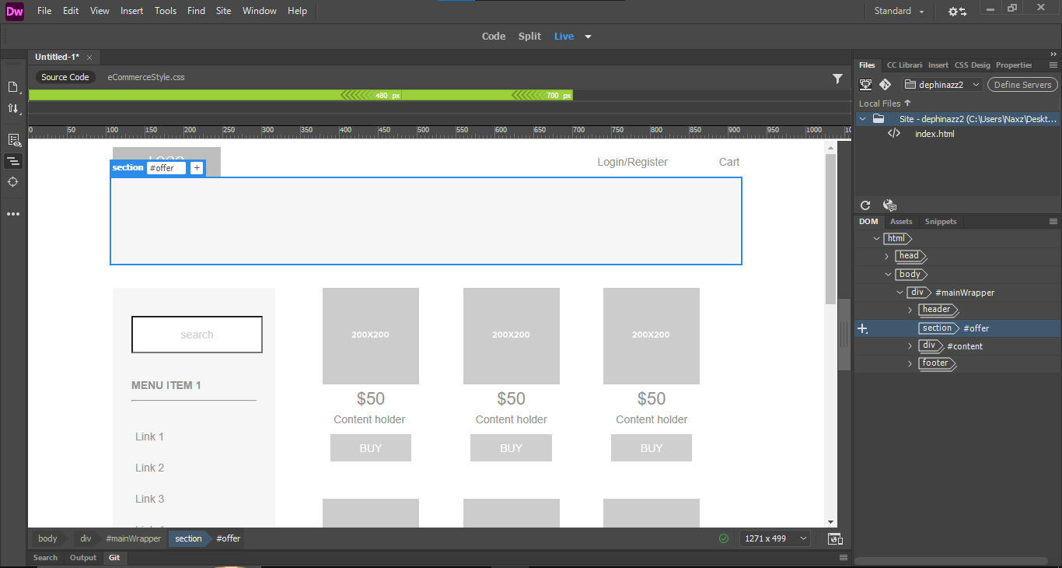
Click and press delete on your keyboard to remove h2, and p from your section element

Slide 14
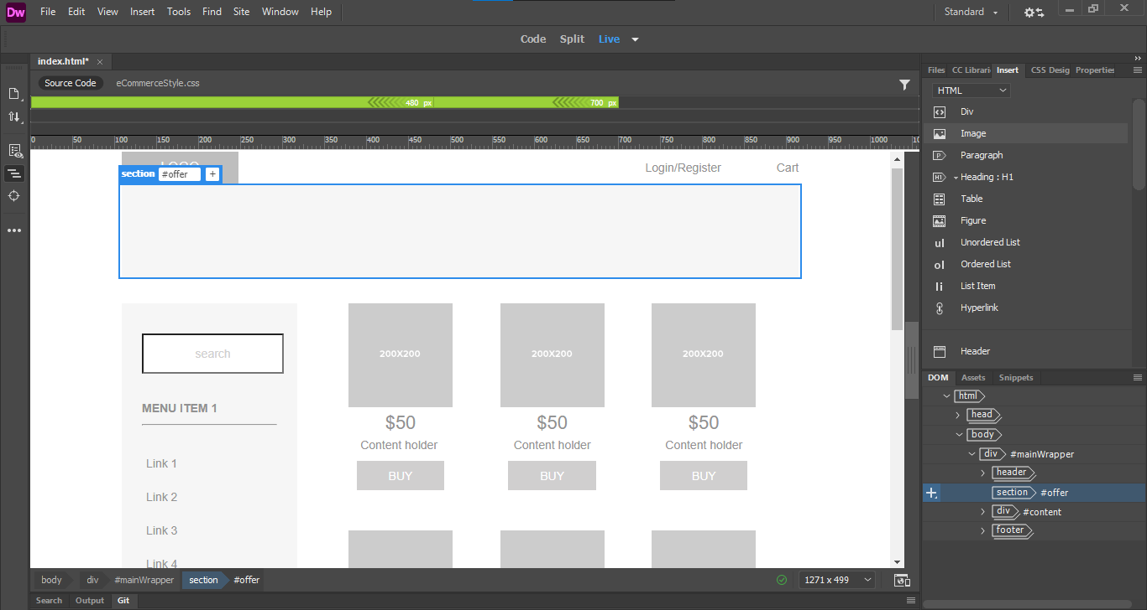
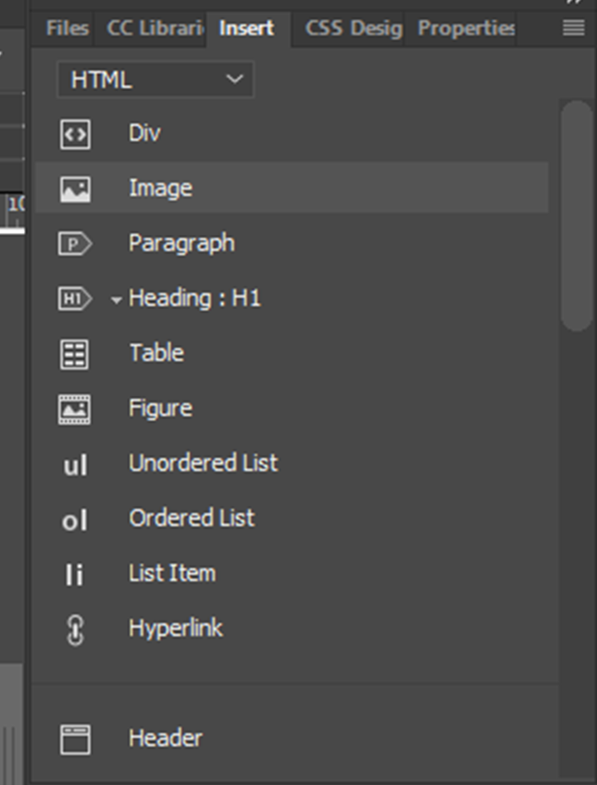
With section element selected, click image on insert tabs, then add your banner image

Slide 15
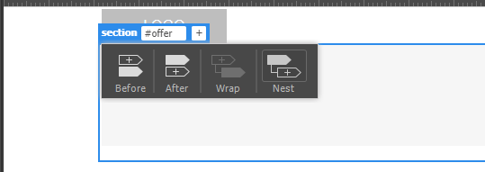
Click nest to insert into the section element

Slide 16
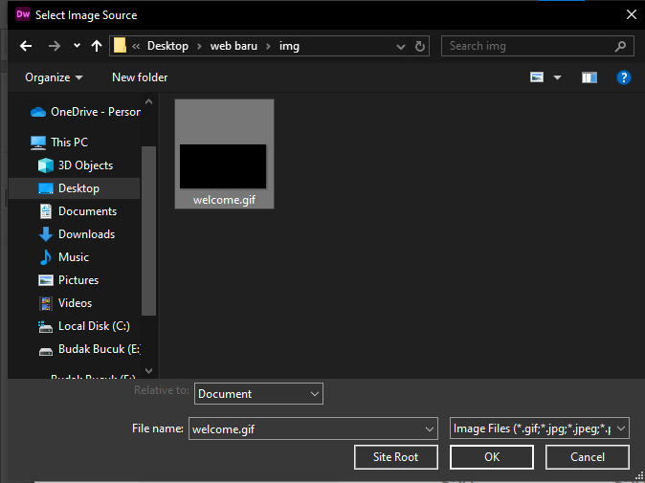
Search for your banner image location

Slide 17
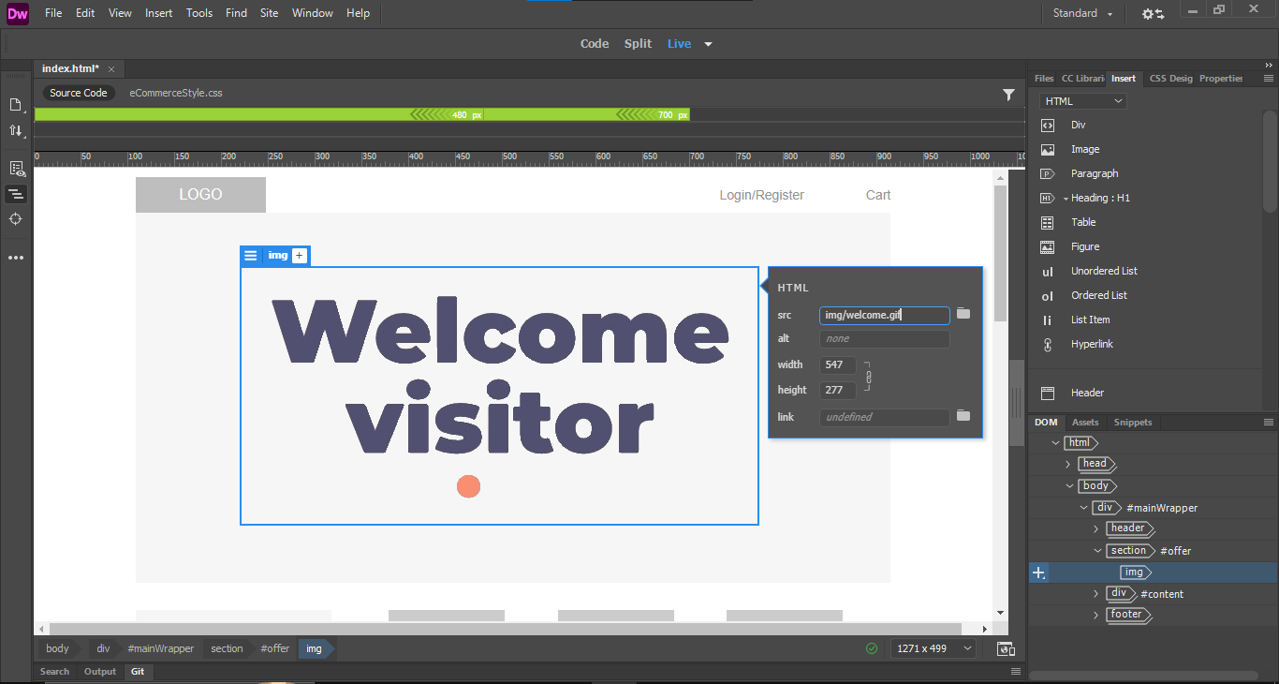
Set your banner size to appropriate size

Slide 18
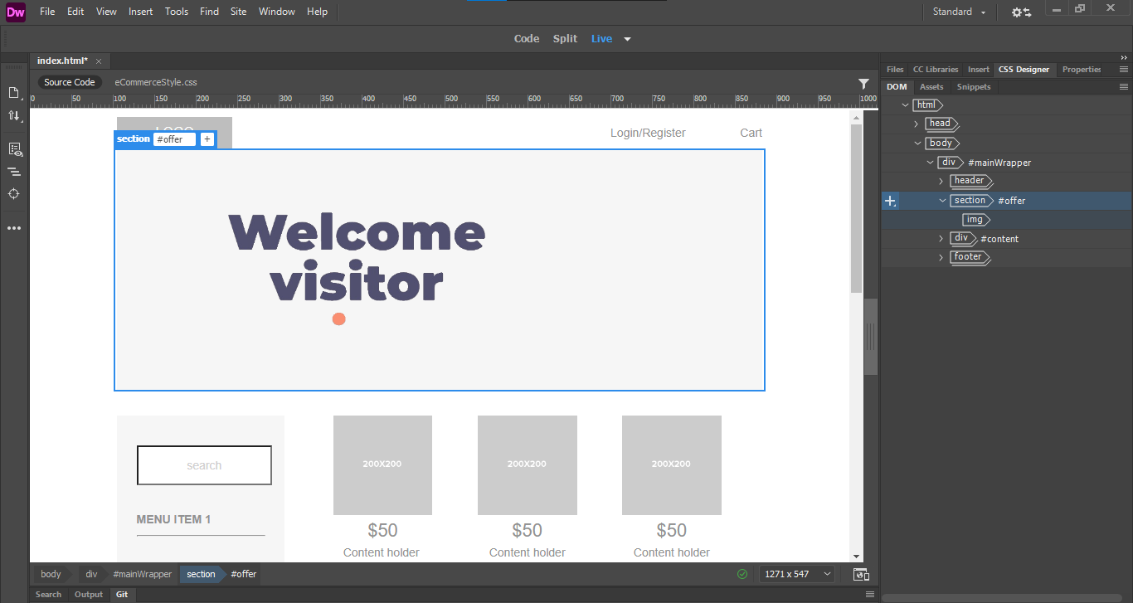
To center the banner image, select the section element on your DOM tabs

Slide 19
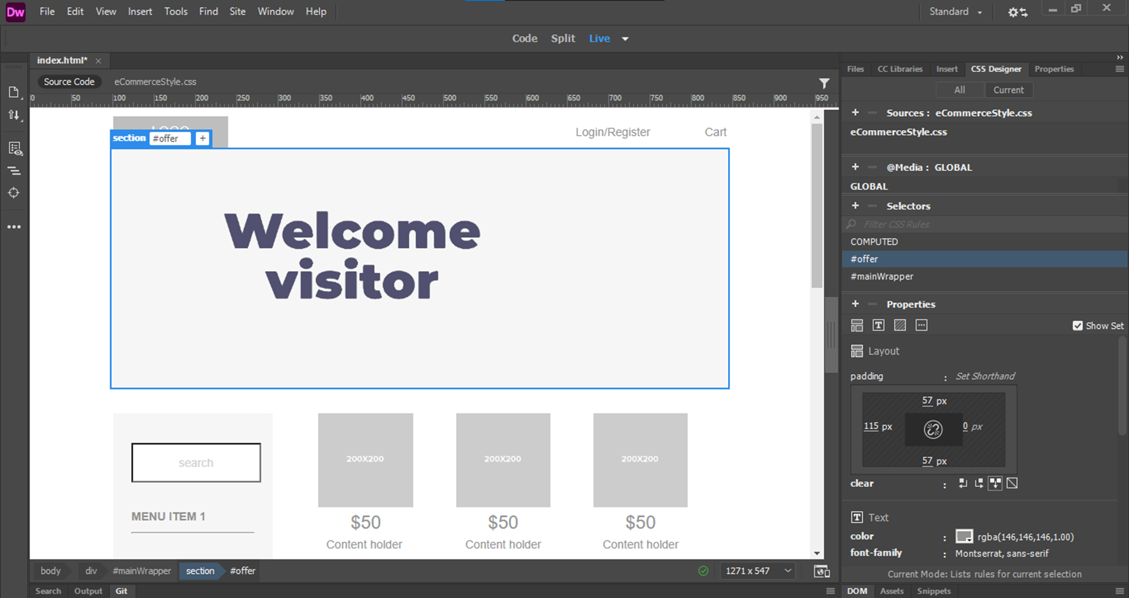
With section element selected, go to Css Designer Tabs on the right

Slide 20
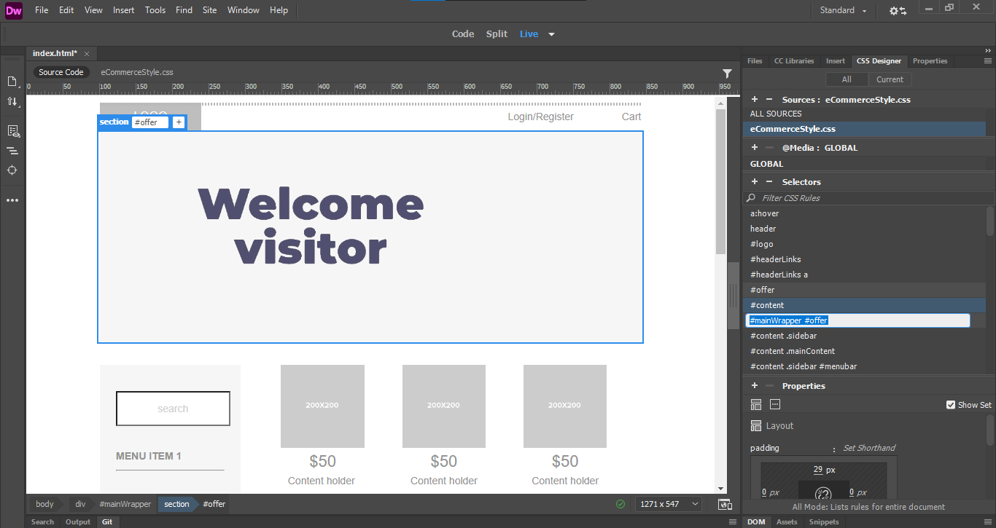

*Make sure your section element still selected.
Click add Selectors
1. Click plus button on selectors tab
2. Then click enter

Slide 21
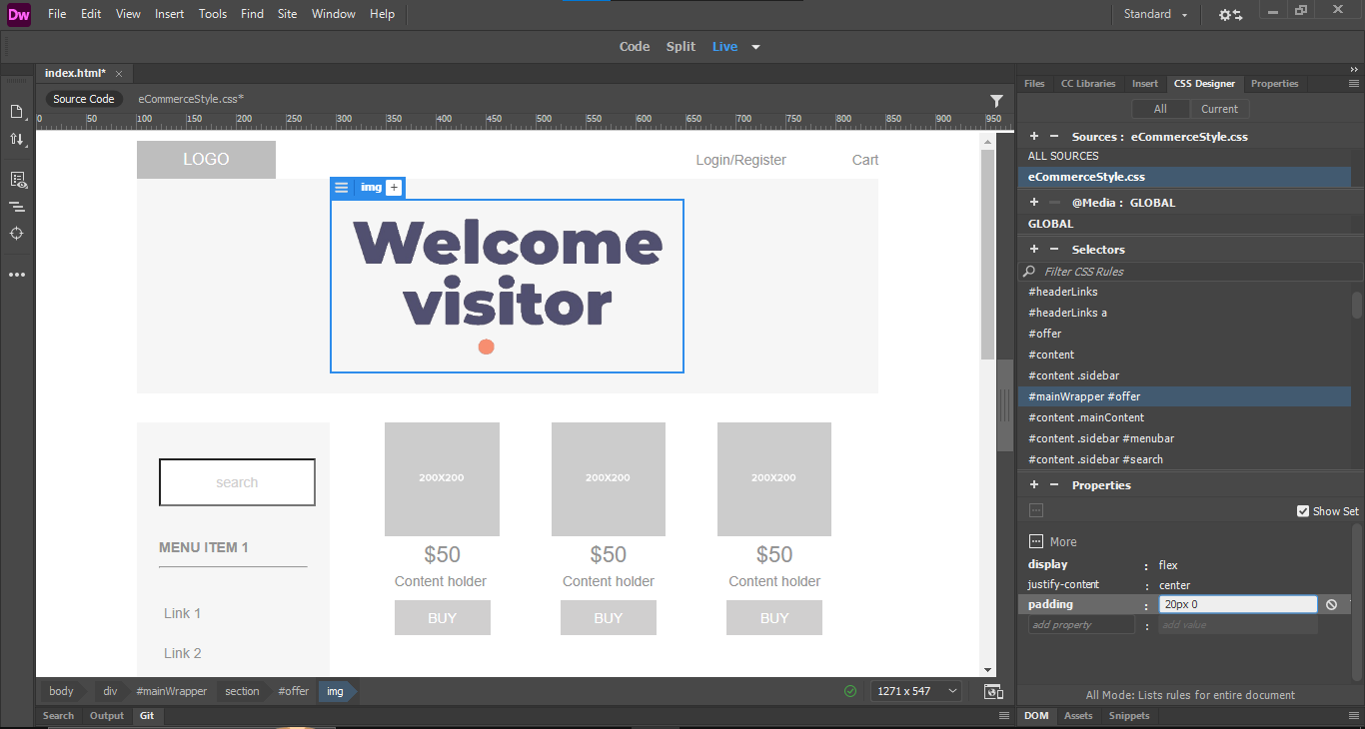
1. Select this selector firts
display:flex;
justify-content: center;
2. Then, on Css Designer > Properties
Add and Type this design for center the banner image on section element

Slide 22
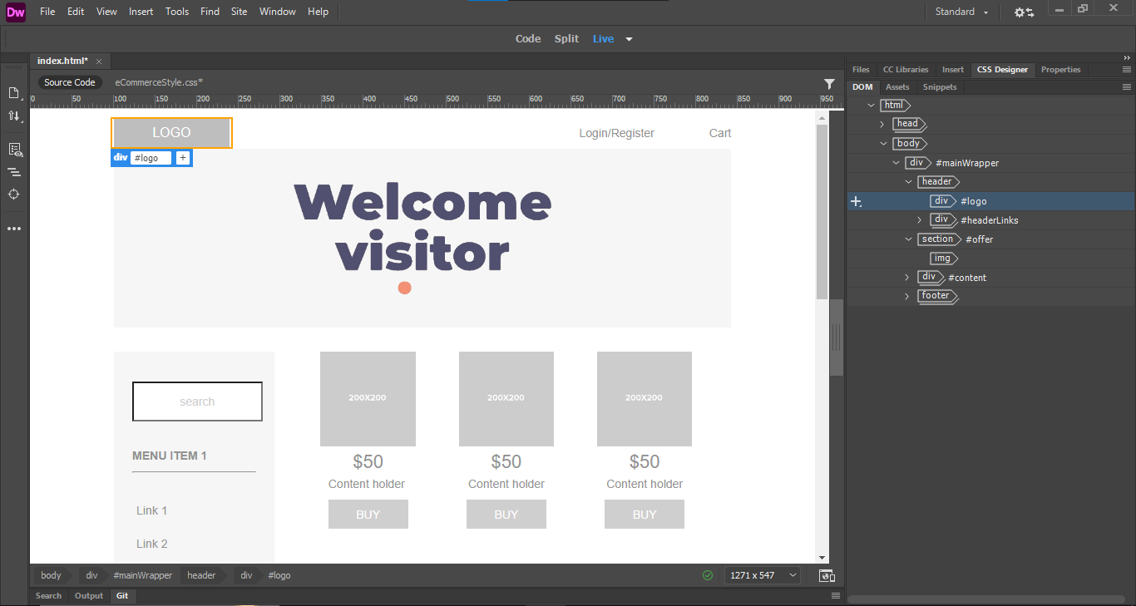
Select this logo div, delete text and add your logo nest to this div
Now go to DOM tabs to edit another element

Slide 23
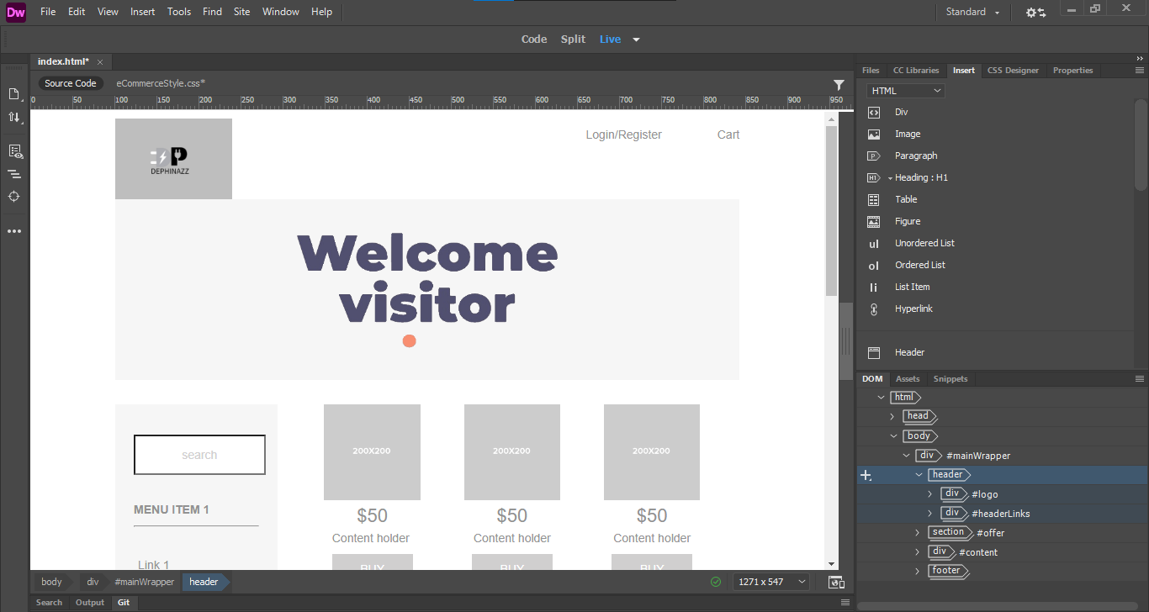

Slide 24
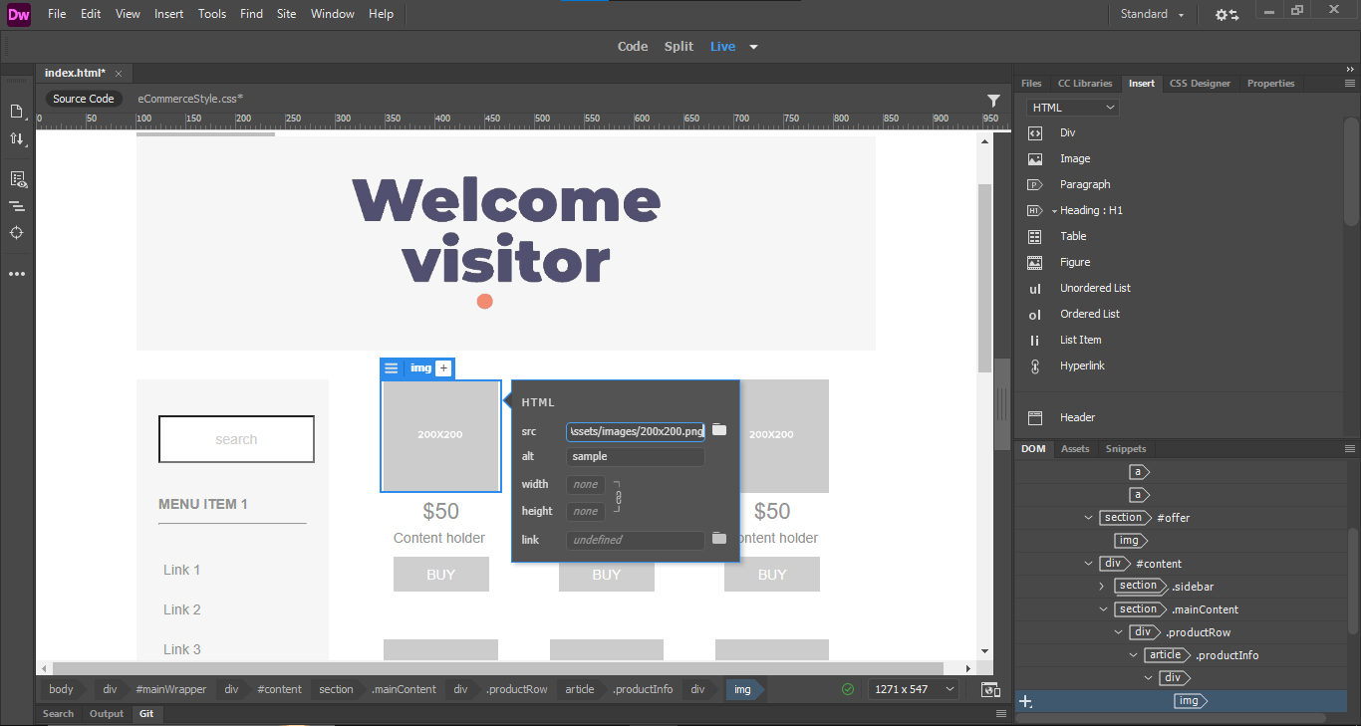
2. Now change your product’s image on src field
1.Click this

Slide 25
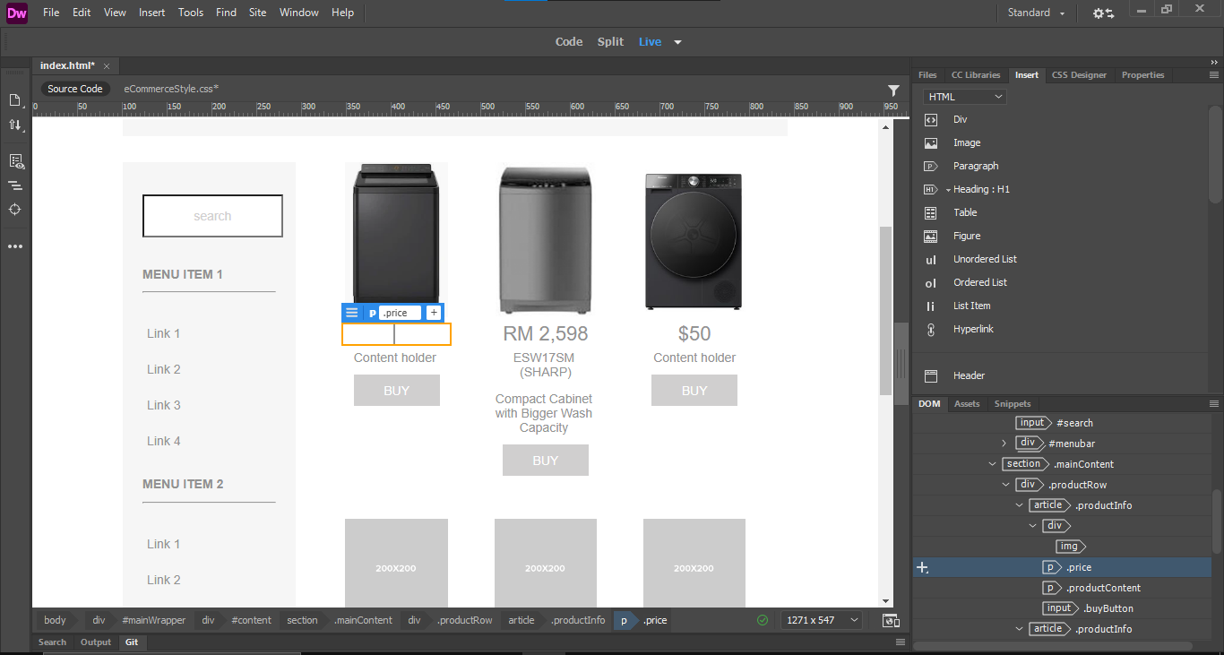
Then to change your text,
just click and edit custom text

Slide 26
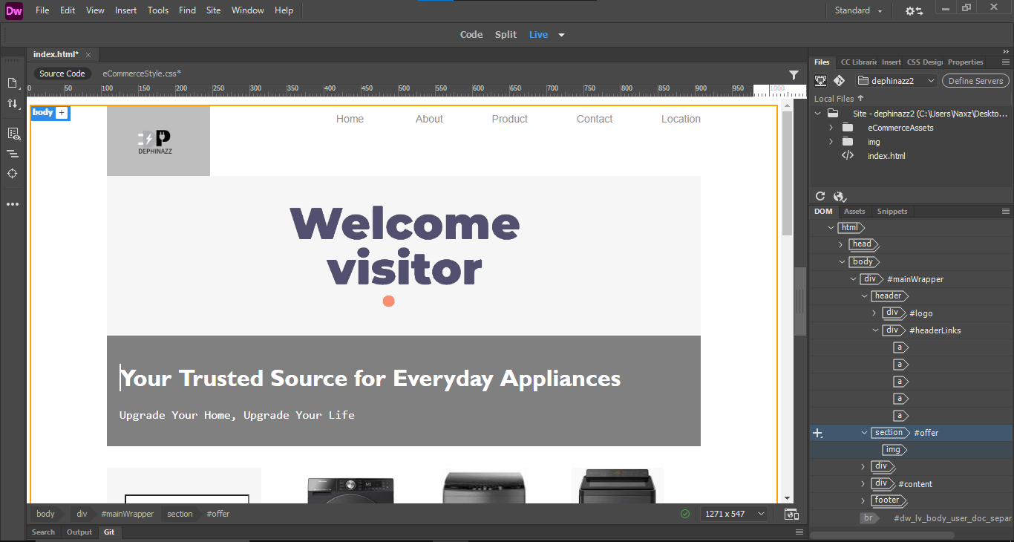
Now, to make another page

Slide 27
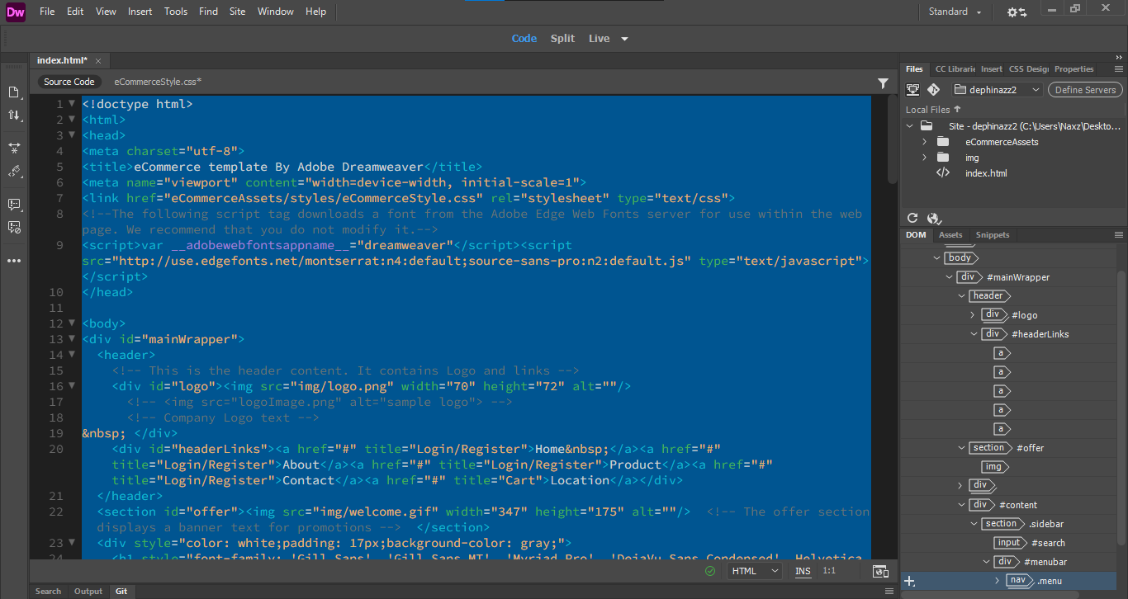
Select all code of index.html with CTRL+A then copy with CTRL+C keyboard button

Slide 28
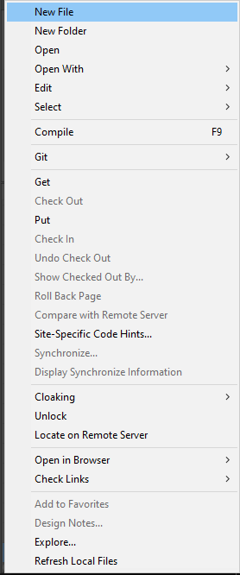
On your site folder, right click then create new page file with “name.html”

Slide 29
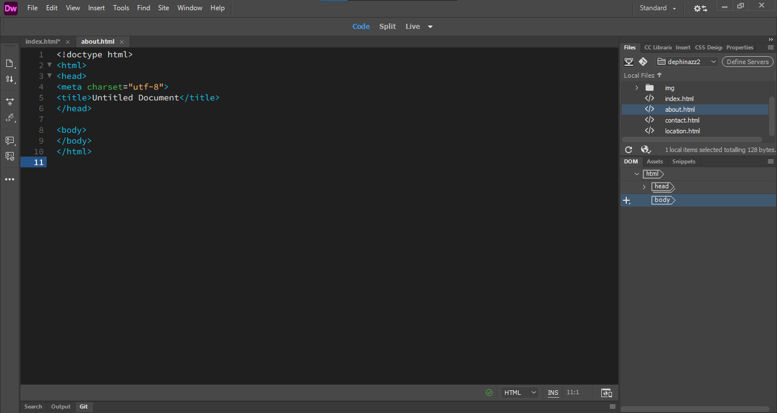
1. Double click your html file to open it
2. Clear code text in this file then paste the code that you copy from index.html before

Slide 30
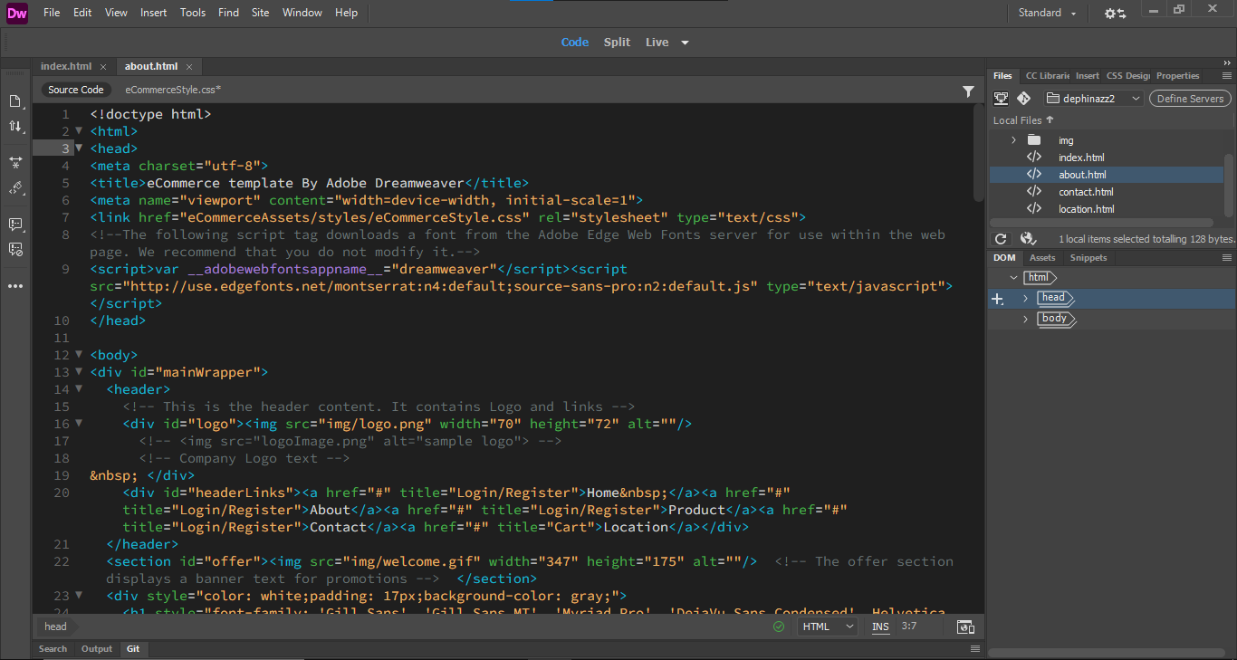
Then open this Live mode to view our new page

Slide 31
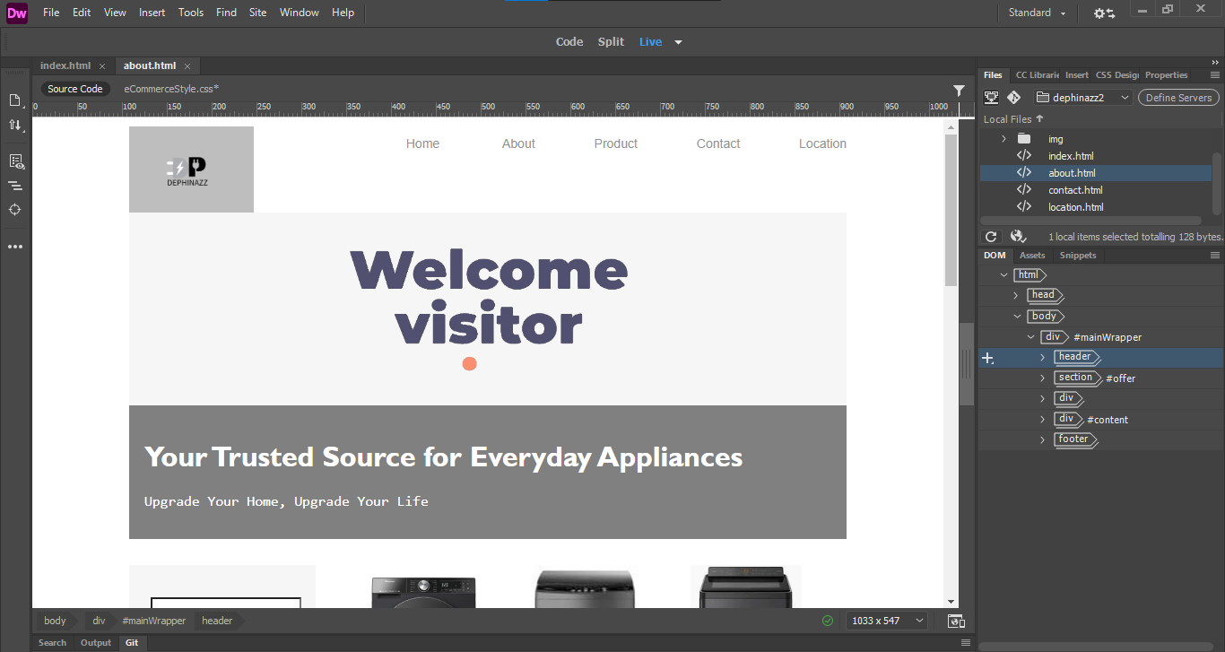
Edit this new page into your new page and
Select unnecessary section then press delete button on your keyboard button

Slide 32
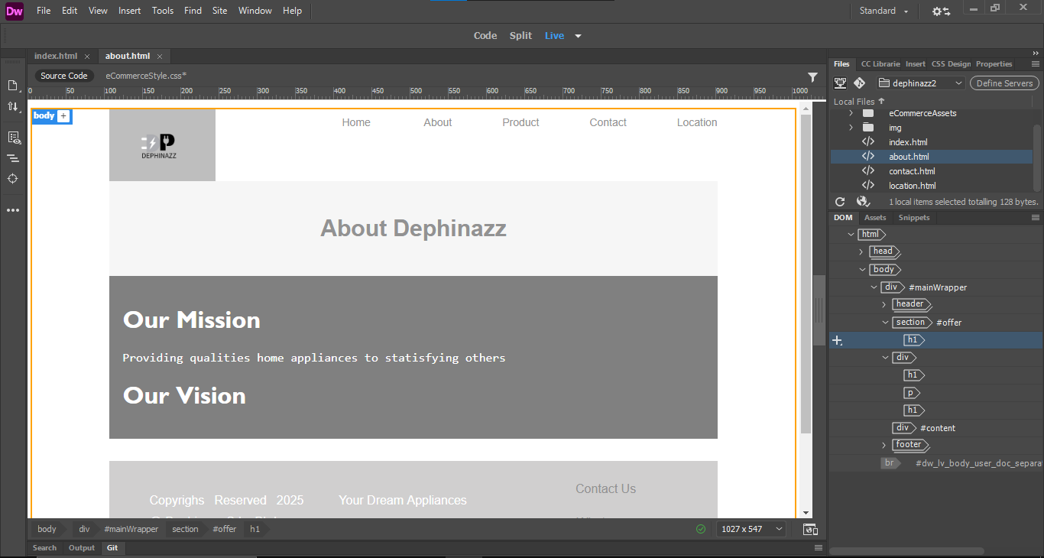
Continue edit same step on other page, copy and paste code then edit page layout

Slide 33
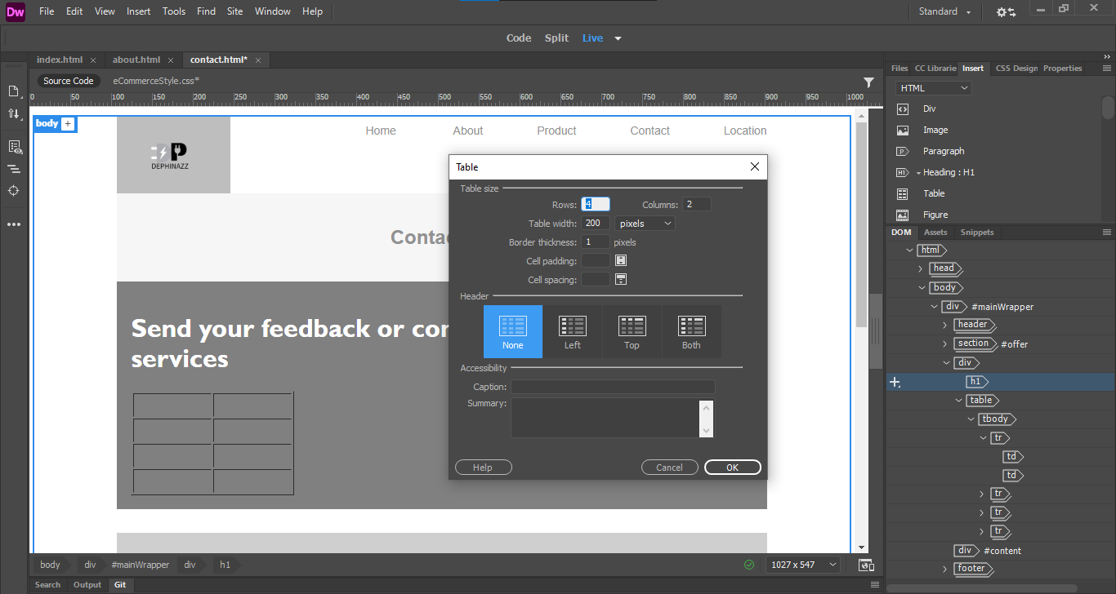
Making a contact form
Add table to organized contact form

Slide 34
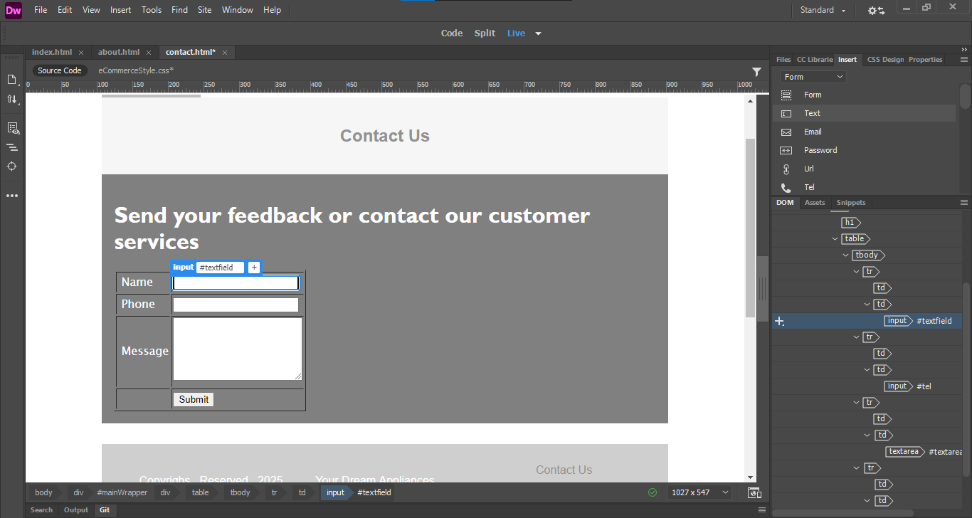
Now, add text field inside the table, also add the button from insert tab

Slide 35
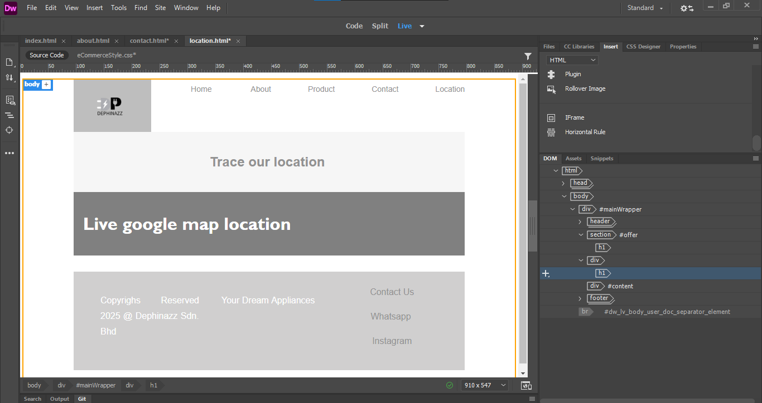
To display live google map location go to
https://www.google.com/maps

Slide 36
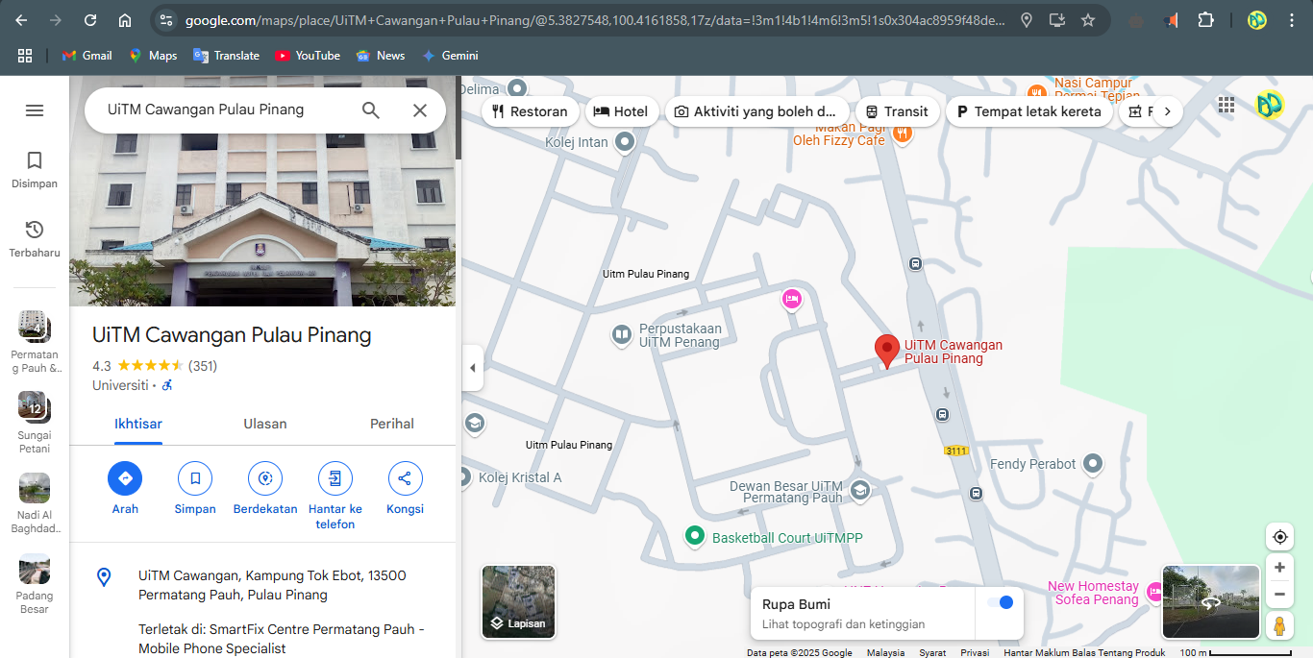
1. Search for your business location
2. Then click share

Slide 37
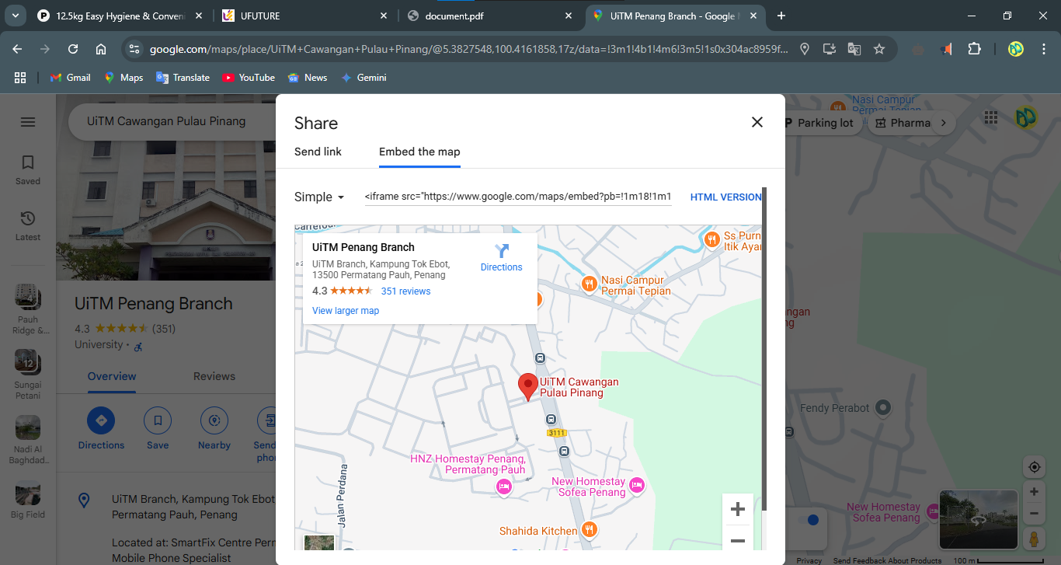
Click embed the map then copy the code given

Slide 38

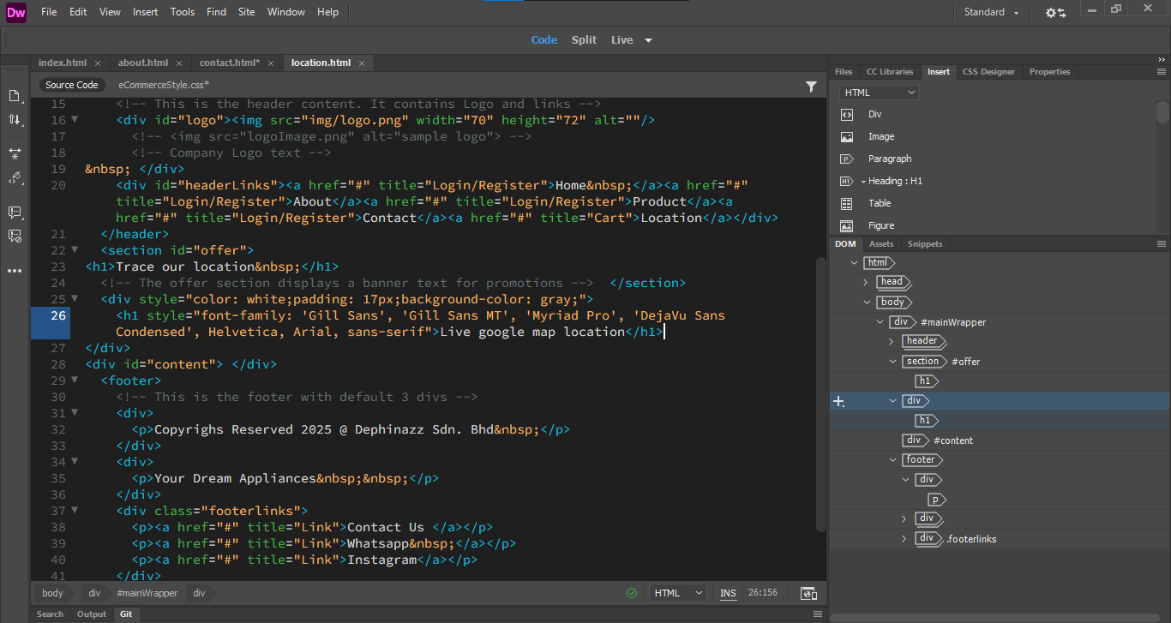
1. Go to code mode
2. Search this text in code

Slide 39
Paste code that you copy from google map website
After this h1 element because the text in h1 element
Paste after this

Slide 40
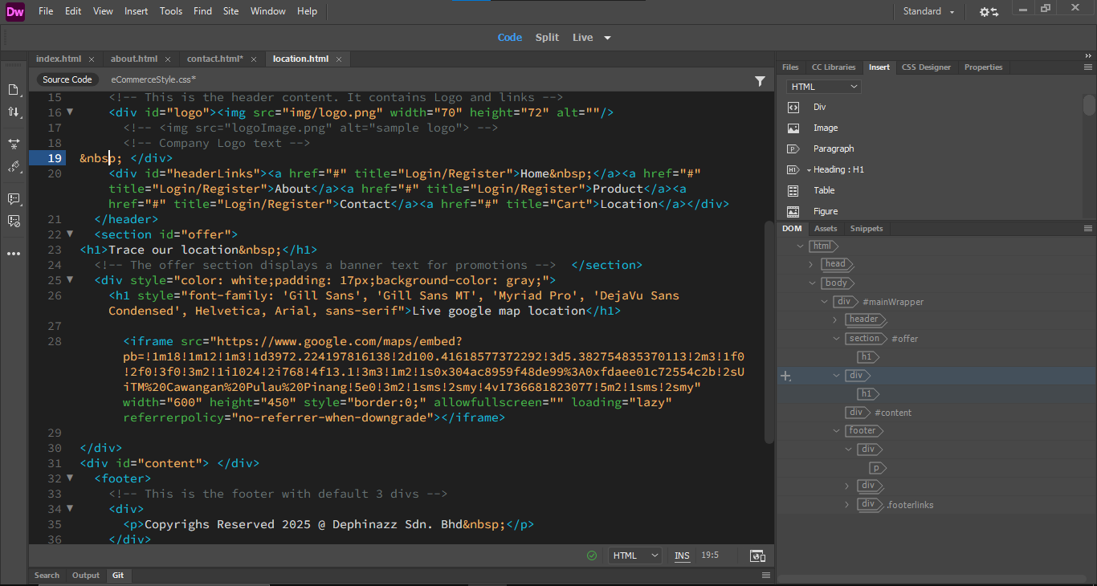
Then back to live mode

Slide 41
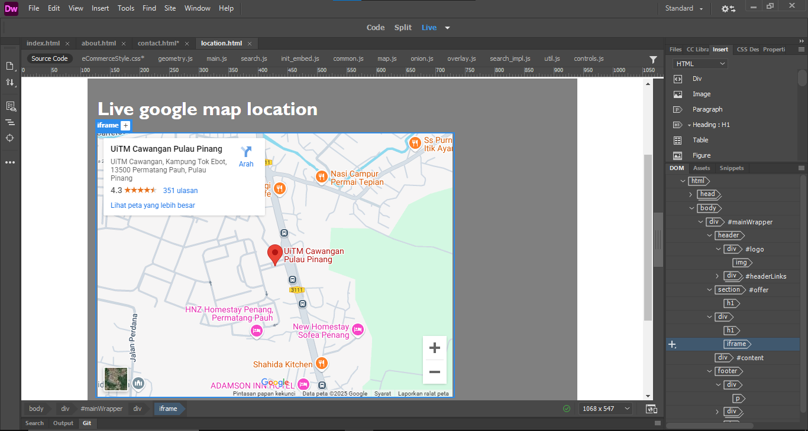

Slide 42
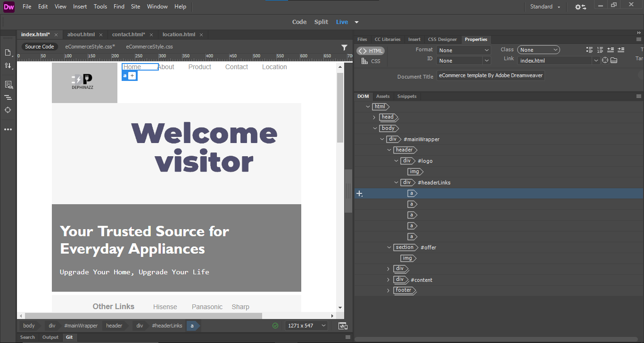
Link to other web page location
To linking the page, click link then link to another file

Slide 43
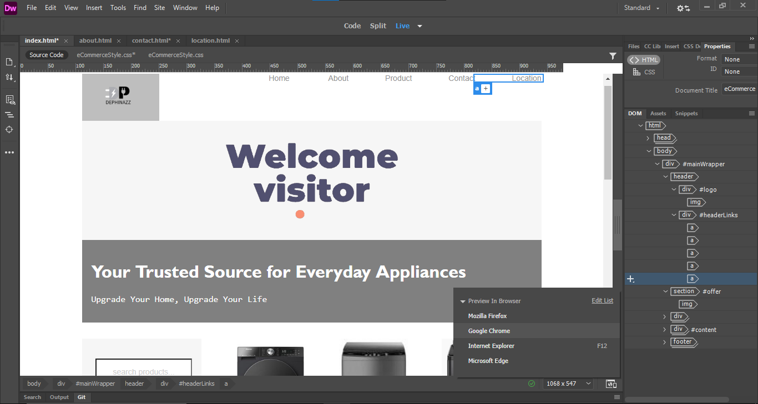
2. You can open on chrome
1. Click preview to preview your web on browser

Slide 44
THANKS FOR YOUR
ATTENTION
- Daniel Hakim -
- Glenn Sachiel -
- Hazrie Sham -
Slide by Group 3

Slide 45
THANKS FOR YOUR
ATTENTION
Slide by Group 3
- Daniel Hakim -
- Glenn Sachiel -
- Hazrie Sham -

Slide 46
- Daniel Hakim -
- Glenn Sachiel -
- Hazrie Sham -
THANKS FOR YOUR
ATTENTION
Slide by Group 3

